Slide 1
Wireless LAB: 802.11b And Data Transmission Over Bluetooth
Ram Yadav
Course# CS M117
2018 Fall UCLA
November 7 2018

Slide 2
Abstract/Goals
Our main goal for this lab 1 was to investigate data transmission over 802.11b Wireless LAN using different transport protocols and in the presence of noise sources. We gained the knowledge of various factors affecting data throughput in a wireless channel and the effect of sporadic losses on TCP throughput. To accomplish this we measure the UDP and TCP data throughput using Iperf measurement tool at different locations in Boelter Hall.
For the 2nd lab, In contrast to Lab 1 our main goal was to gain the basic knowledge of effect of distance and Bit Error Rate (BER) on data transmission. We got to know the effect of one-to-many connection on Bluetooth data transmission. We also get to experiment the Interference among Bluetooth devices. Interference and fairness between Bluetooth and IEEE 802.11 devices. For this purpose we measure the data throughput using 12test utility on one-to-one connection at different distances and for different packet types. We also measure the data throughput on one-to-three and one-to-five connections. In addition we perform the measurement of TCP data throughput using Iperf measurement tool in three crossed one-to-one connections. The measurement of TCP data throughput in one-to-one connection crossed by IEEE 802.11 data transfer.

Slide 3
Theory – Background of WIFI
The wireless LAN setup utilize the Infrastructure-mode of the 802.11b Wireless LAN adapters in the laptops in conjunction with a Linksys access point(as opposed to the Ad-hoc-mode where an access point is not needed).
Using of DHCP (Dynamic Host Configuration Protocol) server provided by the access point, and the IP address will be dynamically allocated as done in home or public access wireless networks.
The IEEE 802.11 wireless uses the two main Media Access Control. One is a base station like modem and other is Ad Hoc networking. If the is base station presence, then the first preference will go to wired network connection with the base station otherwise connect with the Ad Hoc networking.
When there is a busy channel the transmission will be slow because of the protocol like Carrier Sense Multiple Access/Collision Avoidance
Packages are sending in a small fragments over the networks and hence a checksum uses to track those fragments
We use Datagram protocol and Transmission protocol with the Transport layer
TCP protocol is considered reliable for the data transmission because of congestion control and collision avoidance.
Unlike TCP protocol, UDP protocol results potential datagram overlap or loosing and thus is less reliable. However, it gets faster than TCP protocol

Slide 4
Theory – Background of Bluetooth
Bluetooth is considered as a secure short-range wireless network with the 1Mb/s symbol rate and range of 10+ meters
Bluetooth profile can have Generic Access, Service Discovery, Cordless telephone, Intercom, Serial Port, Headset and Dial-up Networking and so on
Bluetooth protocol stack has Application layer, Middleware layer, Data link layer and Physical layer
For the physical link layer is Point-to-pint link (Master slave relationship) with piconet. Each piconet has max capacity of 1Mbps and has fast frequency hopping of 1600 hops/sec
All devices in a Piconet hop together. To form Piconet: master gives slaves its clock and device ID; Hopping pattern (48-bit); determined by device ID; Hopping pattern determined by Clock. A Piconet is centralized TDD system, with master controlling the clock and determined which device gets to communicate in which time slot
For the medium Access Control, Bluetooth with 79 channels can support 79 Mb/s. When a Piconet is established, the slaves add offsets to their native clocks to synchronize to the master and each unit can become a master or slave.
The access is completely contention free and the master implements centralized control
Bluetooth’s main goal is to Impact of distance and Bit Error Rate(BER) on throughput, Effect of one-to-many connection on throughput, Interference among Bluetooth devices, and Interference and fairness between Bluetooth and IEE 802.11 devices.

Slide 5
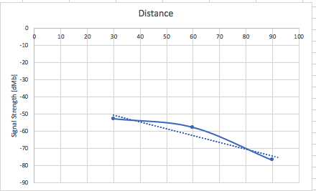
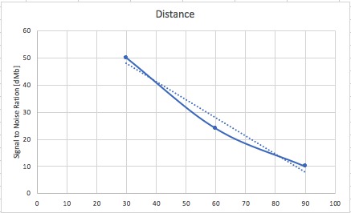
Lab 1 Results
During this lab, we measured the observe the difference
between the throughput of TCP and UDP vs signal strength
using the central server laptop.
From the Fig 1, it can be seen that
increasing the distance will decrease
the Signal Strength. It make sense that as distance
Increases the strength of the signal should be
lowered as we assumed. So, It confirm the reason behind
why we start loosing data as distance increases since data
transmission gets lost more easily.
From the fig 2, it can also be seen that
increasing the distance will decrease
the Signal to Noise Ratio. It implies that with increases the
distance the noise level also increases.
Fig: 1
Fig: 2

Slide 6
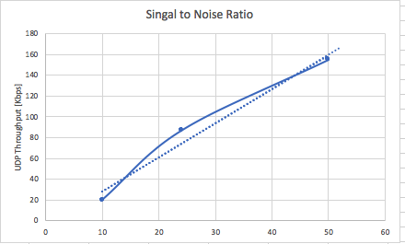
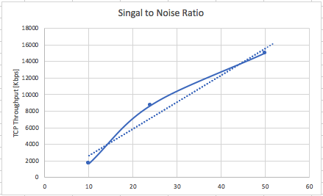
Lab 1 Results
Both in fig 1 and fig 2 UDP and TCP Throughput
increases with increases Signal to
Noise Ratio.
It means that the stronger it is, the faster data will
Be transfer using both protocol
In other words, it concludes that if we want to increase
the rate of transmission, we also should care about
the Signal to Noise Ratio. For better result we should increase
the Signal to Noise Ratio.
Since the data communication link has linear relation
with TCP and UDP protocol, data communication can be
improve with this ratio.
Fig: 1
Fig: 2

Slide 7
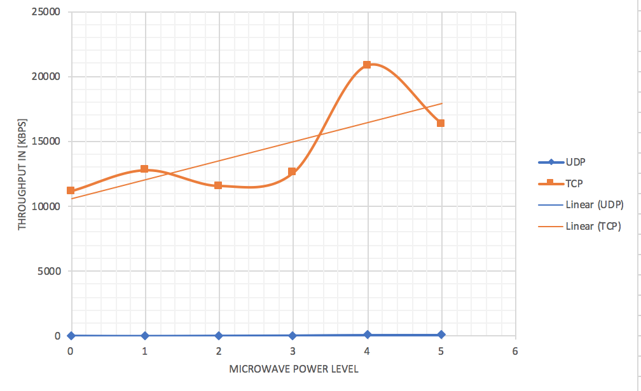
Lab 1 Results
With the microwave power
level (off, warm, deforest,
medium, medium high, and high)
TCP at the very first seems increasing
In its rate but in the middle it decrease and then
Increase and when the microwave gets high
It decrease again. But the linear line shows
That as microwave power goes from lower to
Higher TCP and UDP throughput increases.
The reason could be because of the frequency
of the microwave that is around 2.4GHz range,
which is same as the frequency that modern
computer use for the data communication
Microwave power level:
0=off; 1=Warm; 2=Deforest; 3=Medium; 4=Medium high; 5=High.
Fig: 1

Slide 8
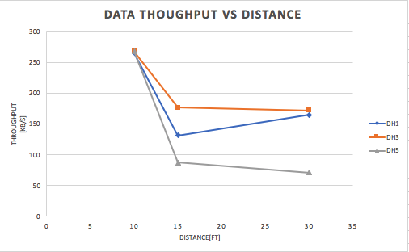
Lab 2 Results
Like in Wifi we noticed, in the
Bluetooth also, as distance increases
The data throughput also decreases.
However, interesting things
from the graph is that that with the
same distance, DH1 has higher
throughput than DH3 and DH5.
In other word, DH5 has lower
throughput comparatively for the same
distance.
Compare to Wifi, Bluetooth data through
put is much lower than both TCP and UDP in WLAN protocols.
Hence it can be concluded that Bluetooth is built for short range distance communication.
Fig: 1

Slide 9
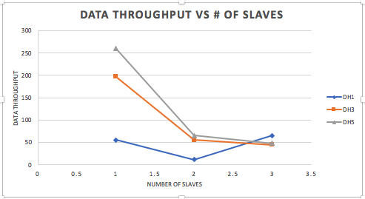
Lab 2 Results
Like Wifi, in Bluetooth also as
the distance from the master
source increases the throughput
decreases.
Compare to previous graph,
generally DH5 seems much faster
Than DH1 and DH3 for the same
Distance.
Interesting fact about this graph is
that WLAN TCP and UDP protocols
Have higher throughput values than Bluetooth.
Hence it can be concluded that Bluetooth is built for short range distance communication.
Fig: 1

Slide 10
Discussion
From experiment we have done in LAB1 and LAB2, it is found that both WIFI and Bluetooth has direct relationship with the distance over communication. As distances increases, the throughput decreases and vice-versa.
It can also be concluded that WIFI has higher bandwidth around 9Mbps for TCP and 25Mbps for UDP than Bluetooth. While Bluetooth DH5 is fastest than DH1 and DH3.
From the experiment, we have also concluded that WIFI is meant for higher bandwidth while Bluetooth is for short distance communication with slower data transfer.
Bluetooth good when there is number of slaves up to max of 7 while WiFi is shared among the multiple computers.
When doing LAB2, we had some errors and because of that we have seen increase and decrease of UDP and TCP throughput as distances increases.
As expected Bluetooth has lot less bandwidth than WiFi.
Because of the higher bandwidth wifi has, it transfer more data than Bluetooth does

Slide 11
Conclusion
Both of the technology share the common ground is that both use of radio waves.
From the experiment done in these two labs between WIFI and Bluetooth, it can be seen that both has benefits and downfalls when it comes to the data communication. Both methods has tradeoff when decide to use. From the experiment, comparatively Wifi has high bandwidth and transmission but at the same time it is expensive and susceptible to noise interference.
Using TCP protocol considered more reliable and has less throughput within Wifi. But using UDP protocol fasten the speed of data transfer and is less reliable. In UDP protocol datagram gets overlap and get lost in transmission.
Relatively Bluetooth on the other hand communicate on the same frequency but it has shorter range communication. Given the same conditions as Wifi, Bluetooth faces losses in the data throughput. However, Bluetooth is cheaper than WIFI.
WIFI can be use for faster transfer as its bandwidth is High (11Mbps) vs WIFI (800Kbps)
Latency for Bluetooth can be 200ms while with Wifi 150ms, hence Wifi is faster
Wifi can act like Bluetooth and can connect two different device in short distance
Wifi is generally more secure comparatively
Wifi consume more power than Bluetooth
Bluetooth supports low number of user while Wifi support high number of users
GFSK modulation technologies is uses by Bluetooth but OFDM and QAM by Wifi
Blueotth technology is scattered ad-hoc technology while Wifi provides asynchronous and time-bounded facility

